Slide 1
Comparative Analysis of ARIMA and Random Forests for Forecasting Brent Crude Oil Prices In Ghana. Group 53

Slide 2
Project analysis slide 10
Background of The Study
In recent years, oil prices have remained volatile, with the price per barrel ranging from a low of $ 31.93 in January 2016 to a high of $ 63.67 in January 2020. Ghana, whose economy is heavily dependent on oil imports for energy, is adversely affected by the instability in oil costs.
In a study, the Institute of Energy Security in Ghana found that the country's energy sector was negatively affected by the fluctuations in oil prices, with the trade balance and monetary position being altogether influenced.
Consequently, forecasting Brent crude oil prices presents a complex challenge, requiring sophisticated analytical techniques and robust modeling approaches.

Slide 3
Project analysis slide 10
Problem Statement
Ghana's economy is heavily reliant on the importation of crude oil and petroleum products, with a significant portion of its foreign exchange reserves being allocated to these imports.
Fluctuations in Brent crude oil prices can have profound impacts on the country's fiscal balance, inflation rates, and overall economic stability.
Accurate forecasting of Brent crude oil prices is paramount for effective budgeting, risk management, and strategic planning within Ghana's energy sector and broader economy.

Slide 4
Project analysis slide 10
Objectives
To investigate the performance of the Autoregressive Integrated Moving Average (ARIMA) model and the Random Forest Regressor model in forecasting Brent crude oil prices for Ghana.
To conduct a comparative analysis of the forecasting accuracy and robustness of the ARIMA and Random Forest Regressor models in the context of Brent crude oil price forecasting.
To provide insights and recommendations for policymakers, energy sector stakeholders, and relevant authorities in Ghana regarding the most appropriate forecasting approach for Brent crude oil prices.

Slide 5
Project analysis slide 10
Methodology
Data Collection
Data Preprocessing
Train-Test Split
Model Implementation (ARIMA and Random Forest Regressor)
Validation of Results
Time Series Forecasting

Slide 6
Project analysis slide 10
Data Collection
Source of Data : Commodity prices collected monthly from Bank of Ghana
Data contains prices of Crude Oil with benchmark Brent from January 2000 to April 2023
Data has 268 unique observations
After cleaning by removing missing data, the observations now become 252 and span from January 2002 to December 2022
This yields 20 years of data collected on monthly basis.

Slide 7
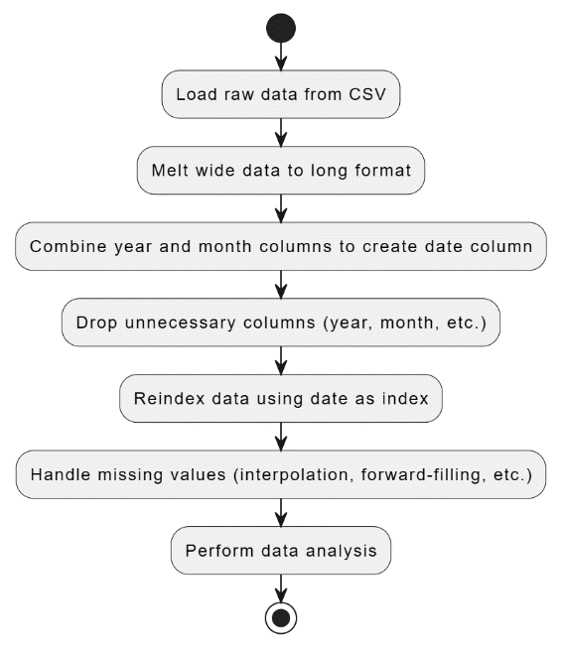
Project analysis slide 10
Data Preprocessing

Slide 8
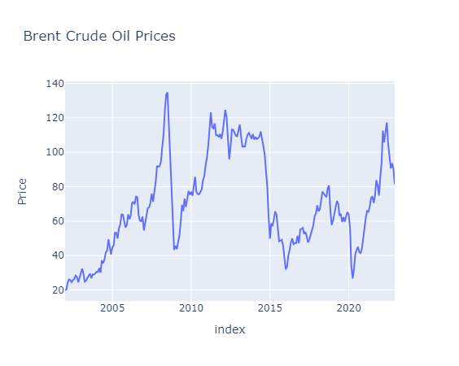
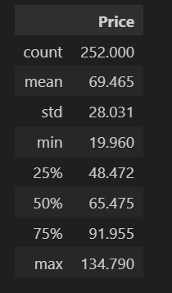
Project analysis slide 10
Data Analysis
The images show the descriptive statistics of the cleaned data.
The next image shows the visual representation of the prices for each of the months in the period (January 2002 to December 2022).

Slide 9
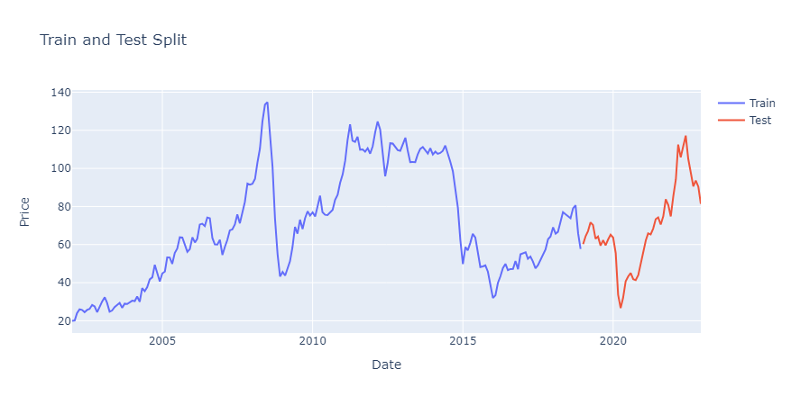
Project analysis slide 10
Train and Test Sets
Train Set : 2002-2018
(204 months)
Test Set = 2019 -2022
(48 months)

Slide 10
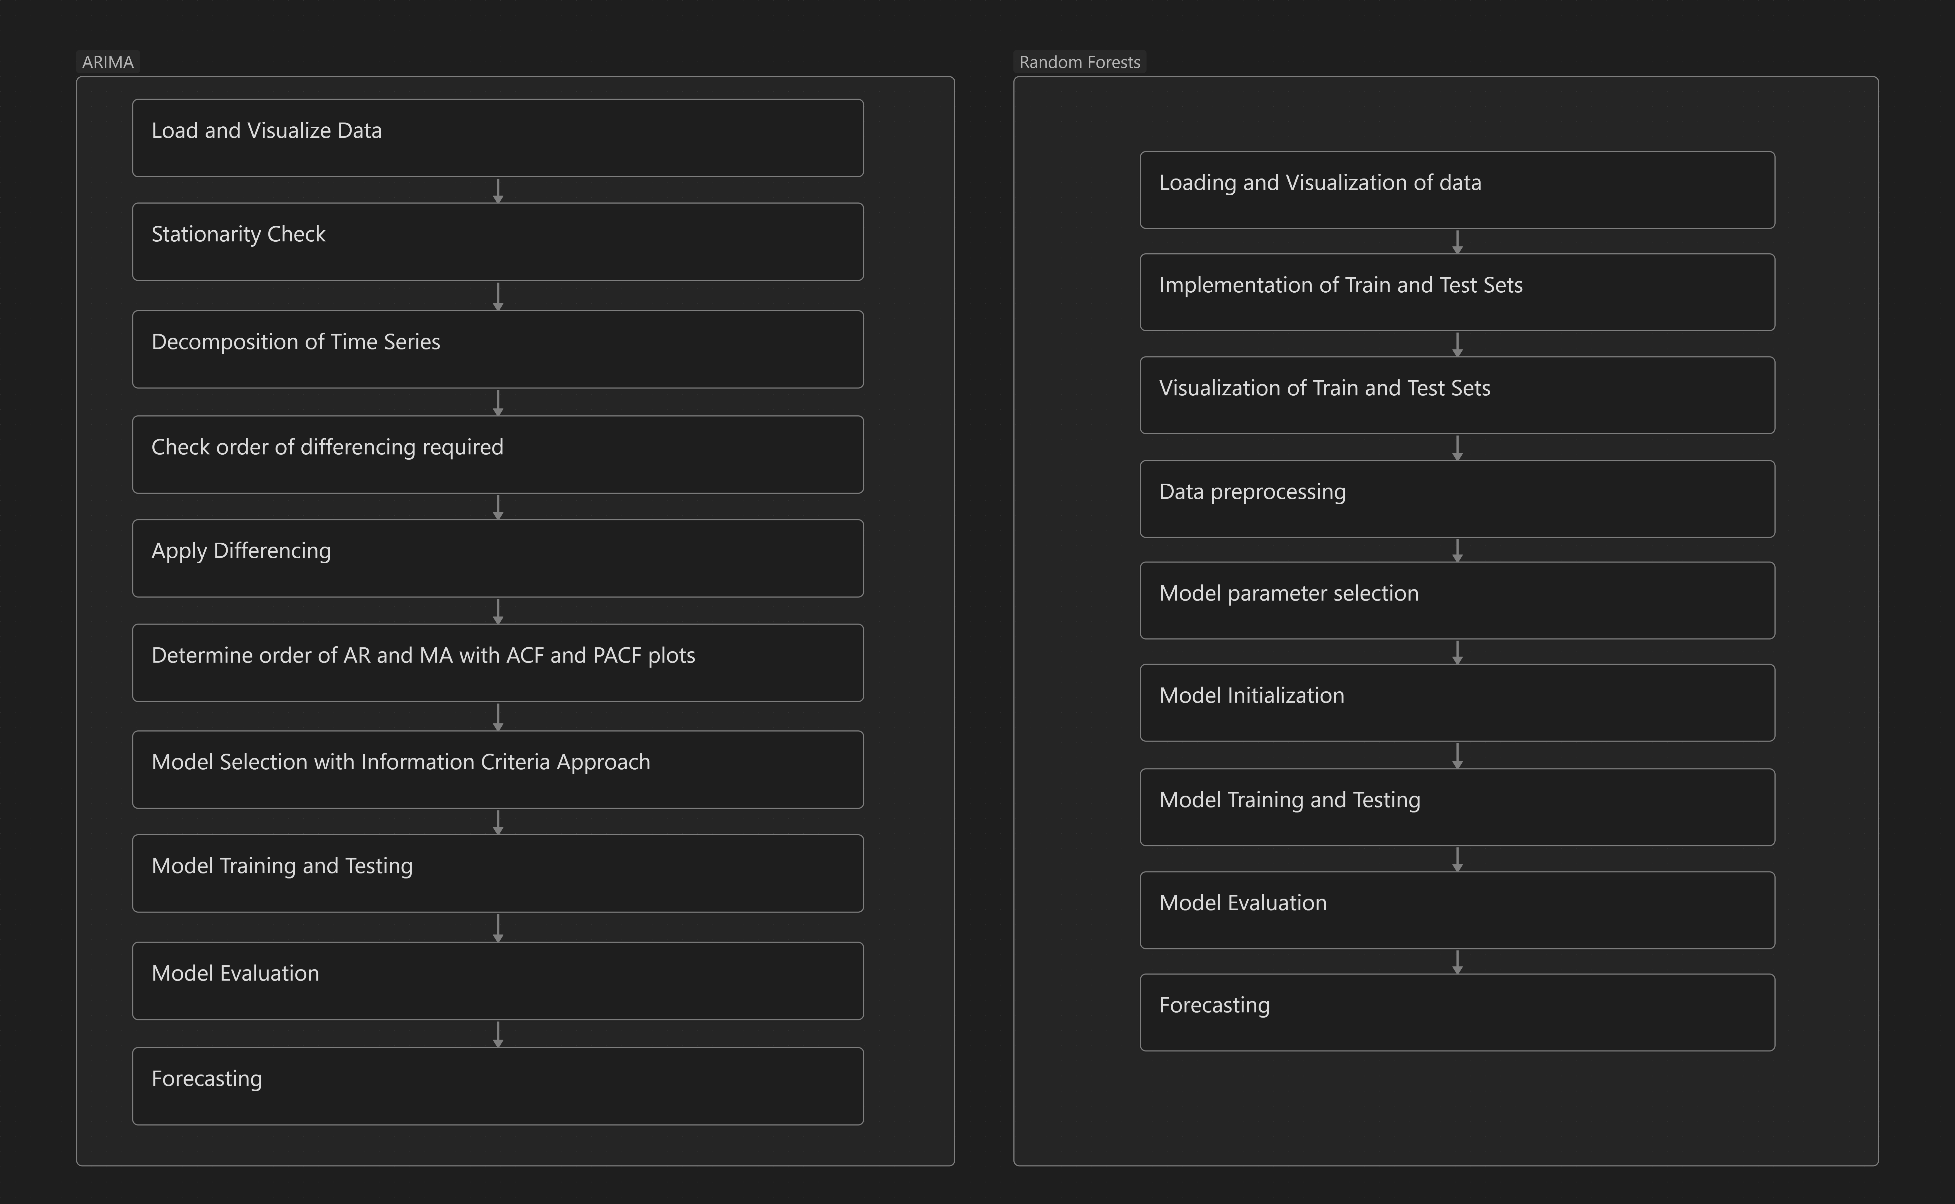
Project analysis slide 10
Model Implementation
The first image shows the steps involved in implementing the ARIMA model
The second shows the processes involved for the Random Forest model

Slide 11
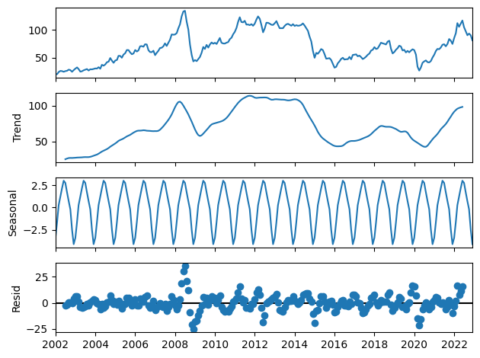
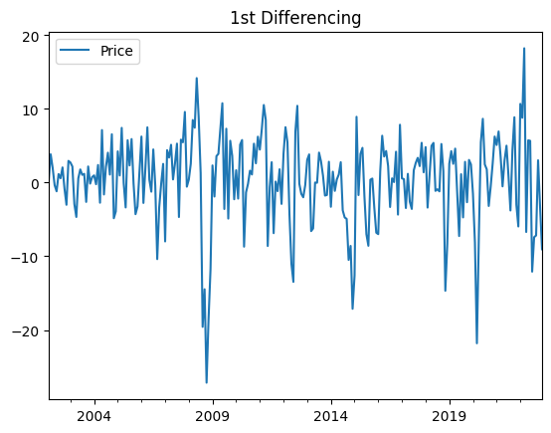
Project analysis slide 10
Stationarity Check and Decomposition
Implementing ADF test for stationarity we realize, the data is not stationary with p-value (0.0473)
We the order of differencing required to make our series stationary to remove trend
We obtain the order of differencing to be 1
No seasonal differencing is required due to constant variance as shown in the image

Slide 12
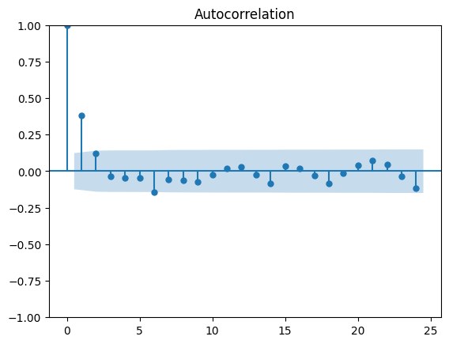
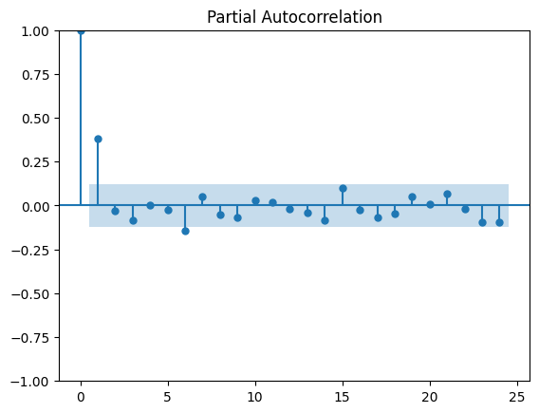
Project analysis slide 10
ARIMA Model Selection
The PACF plot is used to determine the order of the AR process because it shows the direct correlation between an observation in a time series and its lagged values, after removing the influence of any correlations from intermediate lags.
The ACF plot, on the other hand, shows the correlation between observations at different points in time.
Number of significant spike is 1.
We conclude with an AR (1) process.

Slide 13
Project analysis slide 10
ARIMA Model Selection
Model | AIC | BIC | HQIC
ARIMA(2,1,2)(0,0,0) | 1578.236 | 1599.389 | 1586.748
ARIMA(0,1,0)(0,0,0) | 1612.420 | 1619.470 | 1615.257
ARIMA(1,1,0)(0,0,0) | 1575.066 | 1585.643 | 1579.323
ARIMA(0,1,1)(0,0,0) | 1579.935 | 1590.511 | 1584.191
ARIMA(2,1,0)(0,0,0) | 1576.870 | 1590.972 | 1582.545
ARIMA(1,1,1)(0,0,0) | 1576.932 | 1591.034 | 1582.607
Fit competing models and compare with Akaike Information Criterion
We Select ARIMA (1,1,0) as the model of best fit
ARIMA (1,1,0) produces the leas information criteria as shown in the image

Slide 14
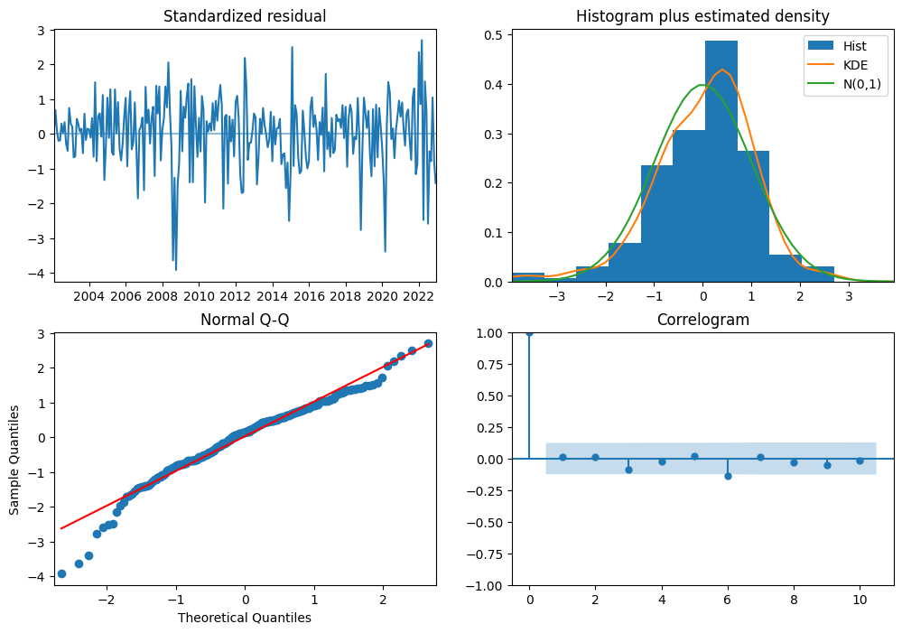
Project analysis slide 10
ARIMA Model Diagnostics
Standardized Residuals: Fluctuations around the zero line suggest that the residuals do not exhibit any clear patterns over time.
Histogram and Density: The histogram of standardized residuals resemble the overlaid normal distribution curve (N(0,1)), indicating normality.
Q-Q Plot: The quantiles of the residuals lie approximately along the reference line if they are normally distributed.
Residuals vs Fitted: No obvious pattern from zero imply that the residuals have constant variance.

Slide 15
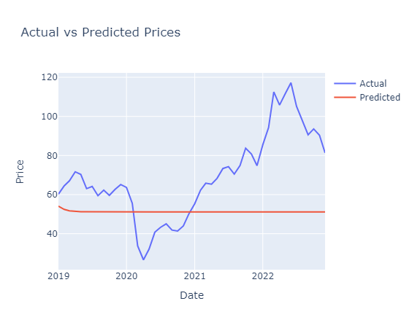
Project analysis slide 10
Actual vs Predicted on ARIMA
We observe that after the predictions on the test set perform poorly and do not follow the actual prices well enough
After some time, the predictions tend to be constant for the rest of the period
This occurs after May 2020

Slide 16
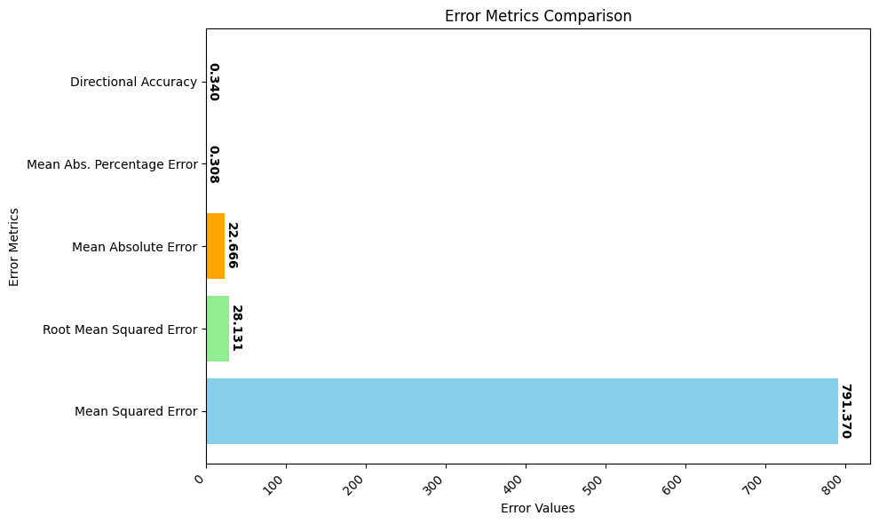
Project analysis slide 10
ARIMA Evaluation
MSE: This measures the average squared difference between the predicted and actual values. A lower MSE indicates a better fit (791.370).
RMSE: This is the square root of the MSE. A lower RMSE indicates a better fit (28.131).
MAE: This measures the average of the absolute differences between predicted and actual values. A lower MAE indicates a better fit (22.666).
MAPE: This measures the average absolute percentage difference between predicted and actual values (30.8%).
Directional Accuracy: This metric (not as common as others) tells you the percentage of times the forecast correctly predicted the direction of the price change (up or down) (30.4%).

Slide 17
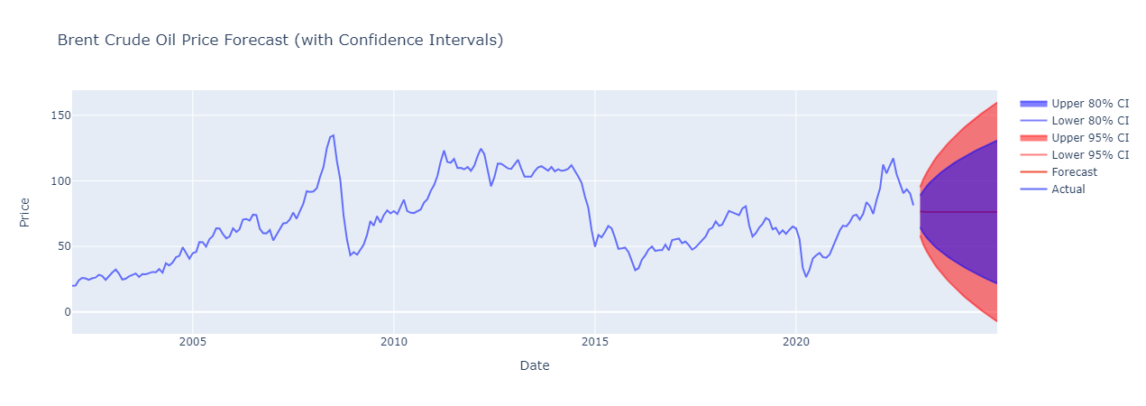
Project analysis slide 10
ARIMA Forecast
This image shows forecast from January 2023 to December 2024
The red thin line shows the forecasted price.
The blue lines show the upper and lower bound with a confidence interval of 80%
The orange section shows the upper and lower bound with a confidence interval of 95%

Slide 18
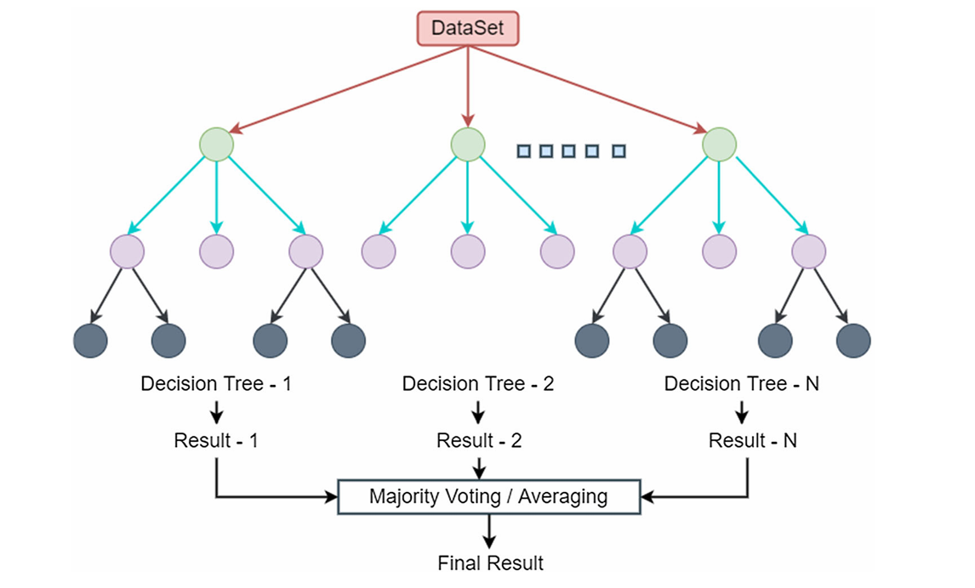
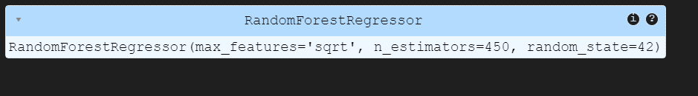
Project analysis slide 10
Random Forest Modelling
Random forest uses multiple decision trees to make predictions by averaging the majority voting as shown in the image
We use Randomized search to select the optimal parameters for our model
We also set a random state to allow reproducibility of the result
We conclude with the parameters shown in the image.

Slide 19
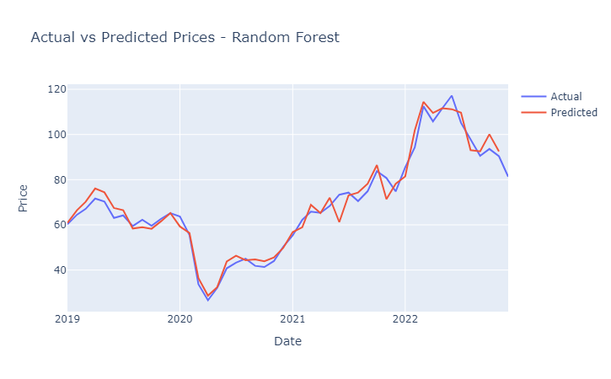
Project analysis slide 10
Actual vs Predicted on Random Forest
We observe that after the predictions on the test set produce excellent performance
The predicted prices follow so close to the actual prices

Slide 20
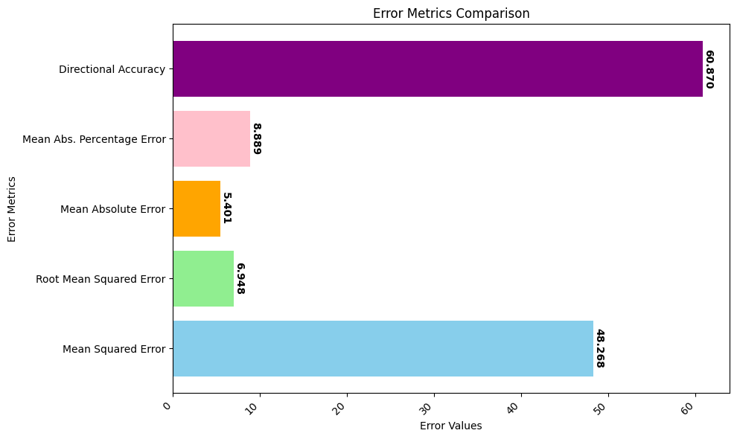
Project analysis slide 10
Random Forest Evaluation
MSE: This measures the average squared difference between the predicted and actual values. A lower MSE indicates a better fit (48.268).
RMSE: This is the square root of the MSE. It's easier to interpret in the same units as your data (USD in this case). A lower RMSE indicates a better fit (6.948).
MAE: This measures the average of the absolute differences between predicted and actual values. A lower MAE indicates a better fit (5.401).
MAPE: This measures the average absolute percentage difference between predicted and actual values. A lower MAPE indicates a better fit, but it can be misleading for large values (8.889%).
Directional Accuracy: This metric (not as common as others) tells you the percentage of times the forecast correctly predicted the direction of the price change (up or down) (60.870).

Slide 21
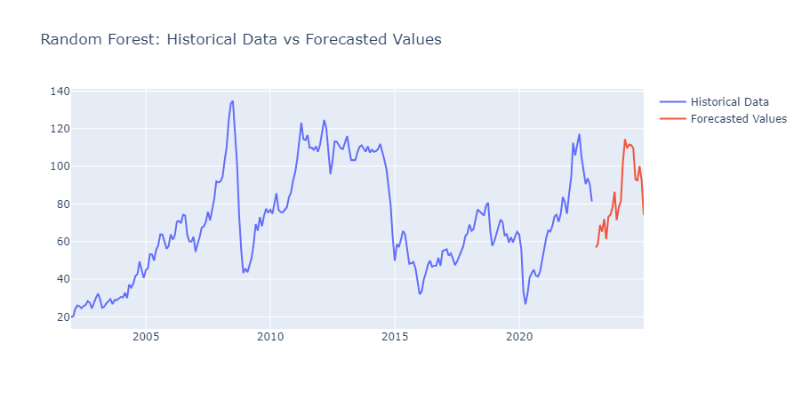
Project analysis slide 10
Random Forest Forecast
This image shows forecast from January 2023 to December 2024
The red thin line shows the forecasted price.

Slide 22
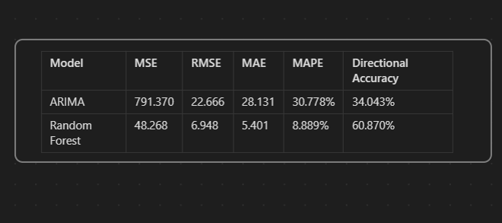
Project analysis slide 10
Conclusion
When compared to the Random Forest model, the ARIMA model has higher error metrics across the board, suggesting that it may not be as accurate in forecasting Brent crude oil prices.
The Random Forest model has a significantly lower MAPE of 8.889% and a higher Directional Accuracy of 60.870%, indicating better performance in both accuracy and trend prediction.
These results suggest that while the ARIMA model can be used for forecasting, the Random Forest model may provide more accurate and reliable predictions for Brent crude oil prices.

Slide 23
Project analysis slide 10
Recommendations
The findings and predictions from our study can assist stakeholders in making future decisions on the allocation of resources and strategic planning.
The Random Forest model is recommended to those who would want to forecast the future prices of Brent Crude Oil. This model has demonstrated superior performance across multiple metrics, including MSE, RMSE, MAE,MAPE and Directional Accuracy, indicating its potential for reliable and accurate predictions.
Lastly, as new data becomes available, it's crucial to retrain the chosen model to maintain the accuracy of future forecasts. This applies to both the ARIMA and Random Forest models.

Slide 24
Thank You

